Slide 1
WATER QUALITY ANALYSIS IN D3JS DASHBOARD
OWOR WILBROAD
2022/HD05/1450U

Slide 2
Development Tools
We build the dashboard using the following languages and tools;
PHP for hypertext processing and routing
Css for styling the pages
Javascript for making the page interactive
D3js for the visualizations
HTML for the web page
Docker for running the code image locally on our local computer.

Slide 3
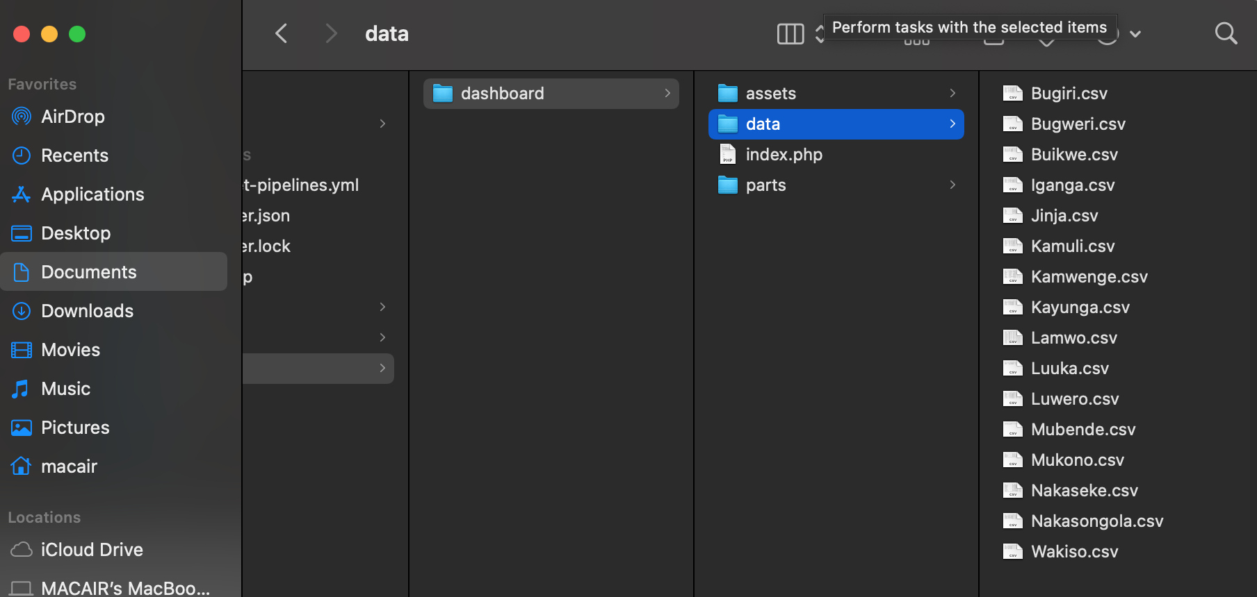
Loading the Dataset

Slide 4
Loading Dataset
In the above slide we organized the datasets in the different csv files in the same way to ease access. We then added its folder into our dashboard folder

Slide 5
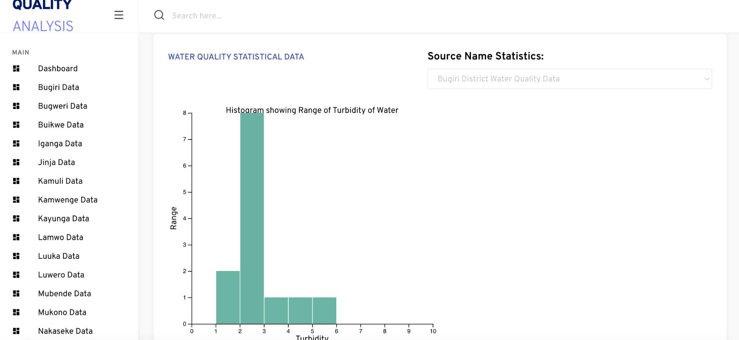
Data Layout

Slide 6
Data Layout
From the previous slide we laid out our data per district to easily visualize each district data independently. With the above Histogram we are able to understand the water Turbidity versus its range per water source.

Slide 7
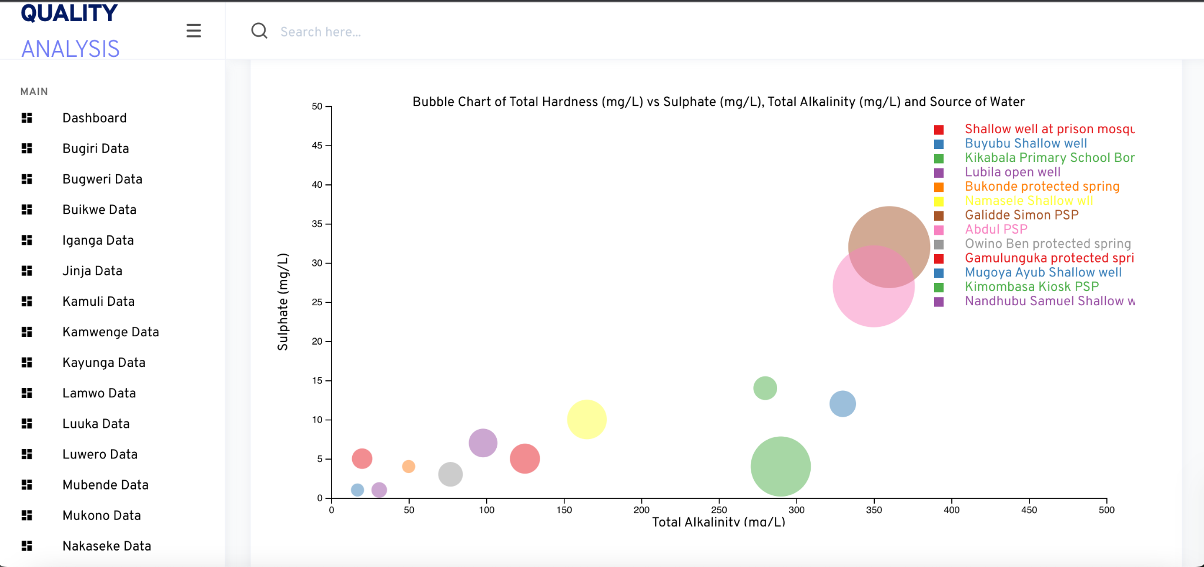
Second Visualization Using the Bubble Chart

Slide 8
Second Visualization Using the Bubble Chart
Using the Bubble chart we are able to analyze Total Alkalinity (mg/L) versus Sulphate (mg/L) of water and from the previous slide we can see that different water sources having different colors help us to know the variations in alkalinity and sulphate.

Slide 9
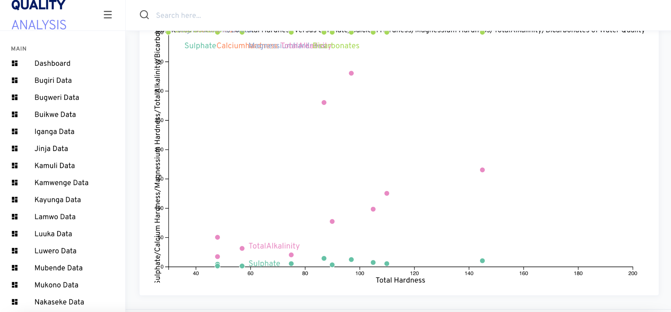
Third Visualization Using Scatter Plot

Slide 10
Third Visualization Using the Scatter Plot
From the previous slide we see Total Hardness Versus Sulphate, Calcium, Magnesium, Total Alkalinity, Bicarbonates with each having a different color. Through this we are able to see the variations of these attributes with respect to Total Hardness of water hence determining water quality.
These visualizations are performed per district independently to help analyze water quality for each district.

Slide 11
The End. Thank you

